Slide 1
data_tructures(&algorithms)
Doan Trung Tung, PhD – University of Greenwich (Vietnam)

Slide 2
Plan
Introduction
01
Course overview, what is data structures, what is algorithms
Coding convention
02
Naming, Formatting
Review important concepts
Memory (static, heap), pointer, allocate memory, struct
03
Procedural Programming
Function, recursive function, procedural programming
04

Slide 3
Introduction
Course overview, what is data structures, what is algorithms

Slide 4
COURSE OVERVIEW
Introduction
Array & Linked List
Sorting
Searching
Stack
Queue
Graph

Slide 5
ALGORITHMS
Simple definition: A set of instructions to perform a specific task in a program.
Popular algorithms:
Swap 2 numbers
Find min, max
Calculate sum, average
Business related algorithms:
Show all employees information
Analyze a log file to detect errors

Slide 6
ALGORITHMS CHARACTERISTICS
Finiteness: An algorithm must always terminate after a finite number of steps.
Independent: An algorithm must not depend on any programming languages
Effectiveness: An algorithm is also generally expected to be effective.
Unambiguous: Algorithm should be clear and unambiguous.
Input / Output: An algorithm takes input and produce output

Slide 7
EFFECTIVENESS
Space: Algorithm should not consume too much space (memory)
Time: Algorithm should run fast to get output
Time
Space

Slide 8
DATA STRUCTURE
Scalar data: numbers, characters, logical values
Operations: +, -, *, /, AND, OR, etc.
Collection data: string, array
Operations: size, length, insert, get at, find, etc.
Struct data: date time
Operations: based on struct
Built-in data is not enough for your problem?
Implement your own data structure: list, stack, queue, graph, tree, etc.

Slide 9
DATA STRUCTURES & ALG.
PROGRAM
needs
DATA STRUCTURES
has operations
ALGORITHMS

Slide 10
DATA STRUCTURES & ALG.
PROGRAM
includes
ALGORITHMS
run on
DATA STRUCTURES

Slide 11
BEFORE REVIEW
BASIC CODING CONVENTION

Slide 12
NAMING
Variables: nouns in lower cases + underscore
name, first_name, start_time
Constants: nouns in UPER CASES + UNDERSCORE
PI, MAX_SCORE, TOTAL_INTEREST
Functions: verbs in lower cases + underscore
max, get_salary, quick_sort, show_info
Names should be clear, explainable
Plural form vs singular form:
for scalar: student, employee, house
for collection: students, employees, houses
Number of: n_dogs, n_points

Slide 13
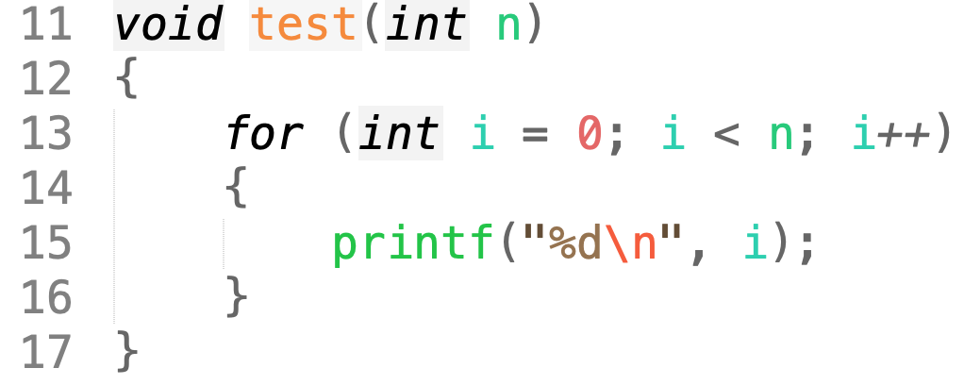
FORMATTING
Use spaces and tabs correctly
Declaration and assignment:
Do : int x = 5;
Don’t: int x=5;
Declaring and passing parameter:
Do : my_func(int x, int y);
Don’t: my_func ( int x ,int y ) ;
Do : my_func(6, 5);
Don’t: my_func( 6,5 );
Control statements:
Do : if (a + b == 5)
Don’t: if ( a+b==5 )
Do : for (int i = 0; i < 10; i++)
Don’t: for(int i = 0 ;i <10;i++ )
Do : Tab
Don’t: Spaces

Slide 14
REVIEW
Memory

Slide 15
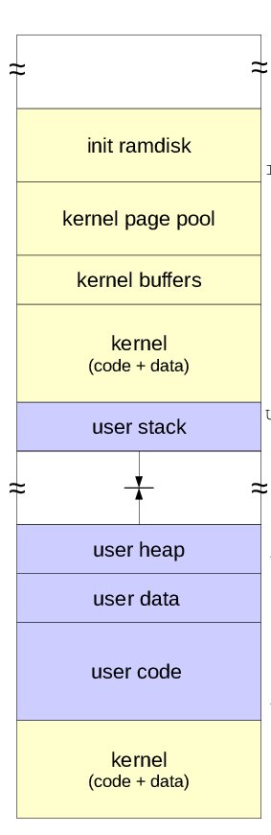
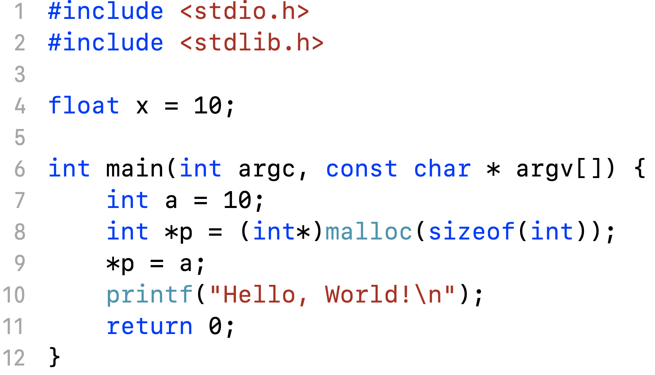
MEMORY IN A PROGRAM

Slide 16
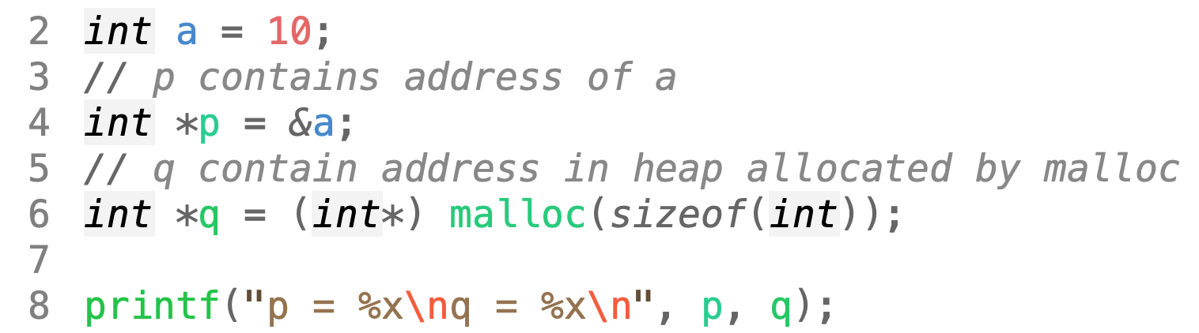
POINTER
Pointers are variables whose values are memory addresses.
Pointer can only point to memory block of same type (except void)

Slide 17
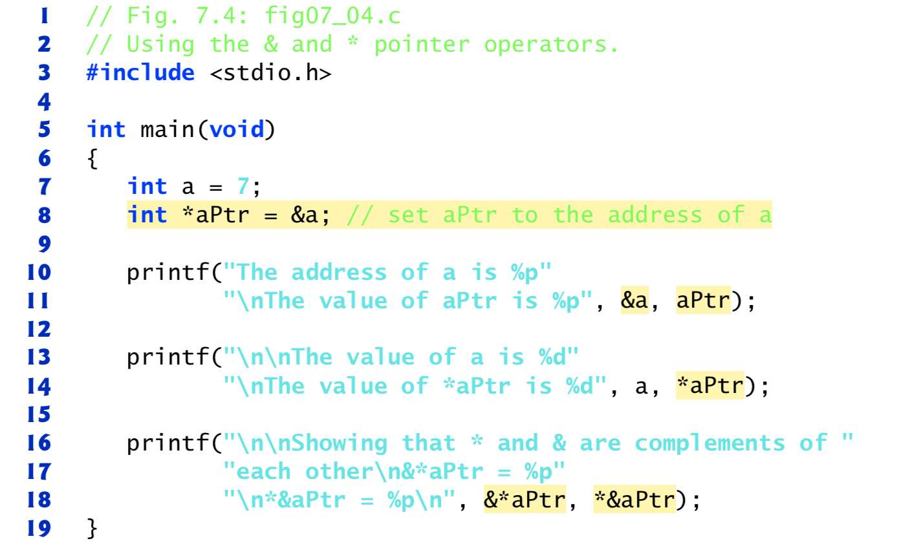
POINTER OPERATORS: &, *
&: Address operator, returns address of a variable
*: Dereferencing operator, returns value where the pointer points to.

Slide 18
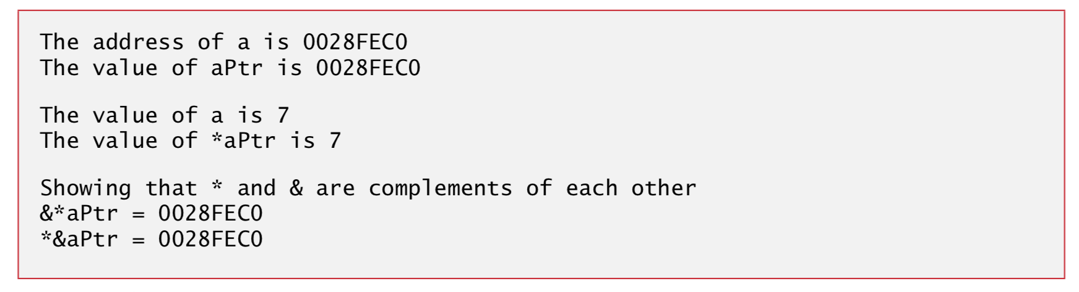
POINTER OPERATORS: &, *
&: Address operator, returns address of a variable
*: Dereferencing operator, returns value where the pointer points to.
[1] C How to program 8th edition, Paul Deitel

Slide 19
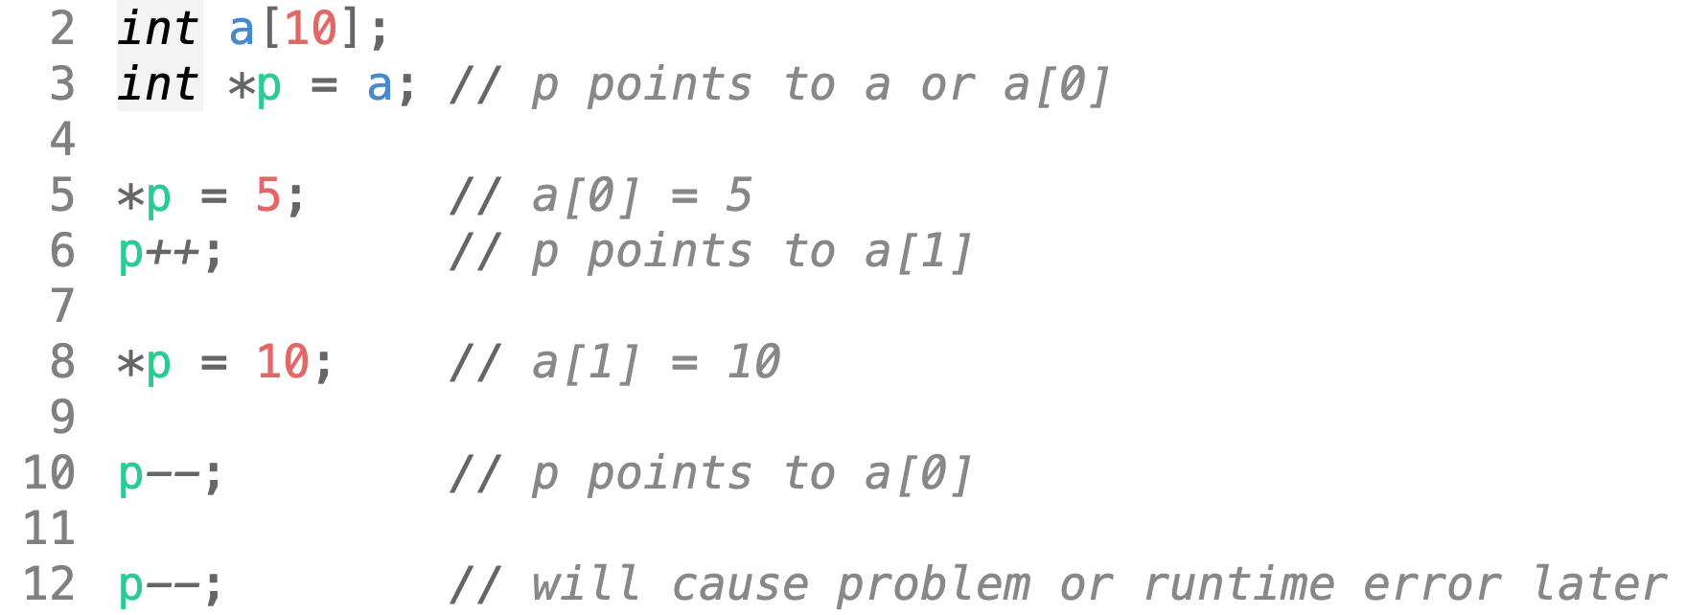
POINTER OPERATORS: ++, --
We can move pointer around by increment, decrement:
++: move to the next memory block
--: move to the previous memory block

Slide 20
POINTER OPERATORS: ARITHMETICS
We can apply some arithmetic operators on pointers (p, q must be the same type):
p = q + 2: move to the next 2 memory block
p = q - 2: move to the previous 2 memory block
other arithmetic operators (*, /, %) are not allowed
a = p – q: how many memory blocks between p & q
p == q: if p & q point to the same memory block
p = q: p & q point to the same memory block
p != q: p & q point to different memory blocks

Slide 21
POINTER: NULL & VOID
A pointer can point to nowhere
int *p = NULL;
int *q = 0; // same as above but NULL is more prefer
A pointer can point to anywhere
void *p = &a; // a is integer
p = &x; // x is float

Slide 22
POINTER: CONST
A constant pointer always points to one memory block, cannot point to some where else.
Array is a constant pointer:
int a[10];
a = p; // error because a is constant
Constant pointer need to initiate at declaration:
int * const p = a;
p = q; // error: p can only points to a
Pointer that points to a constant value:
int b = 10;
const int* p = &b;
b = 20; // ok
*p = 20; // error: cannot change value through p
Constant pointer that points to a constant value:
const int* const p; // cannot change p, cannot change *p

Slide 23
ALLOCATE & DEALLOCATE
Everything in stack will be removed automatically when ‘out of scope’
Everything in heap can only be removed manually (deallocate)
To allocate a memory block in heap:
int *p = (int *) malloc(sizeof(int));
To allocate n memory blocks in heap:
int *p = (int *) malloc(n * sizeof(int));
int *p = (int *) calloc(n, sizeof(int));
To deallocate memory in heap:
free(p);

Slide 24
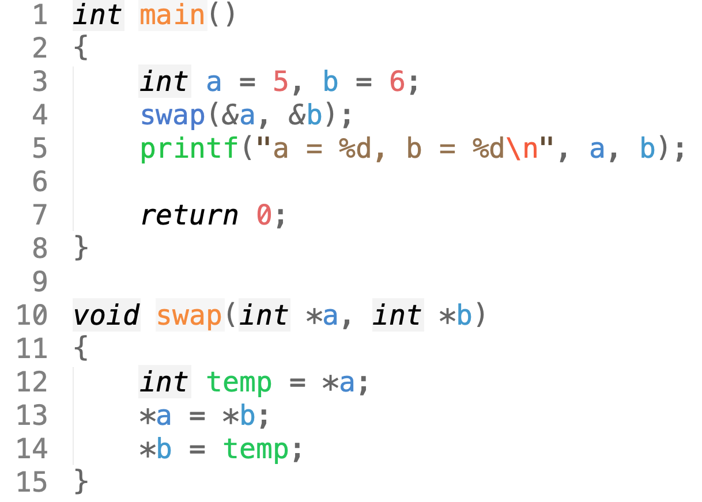
WHY POINTER? WHY HEAP?
Passing parameters to a function by reference

Slide 25
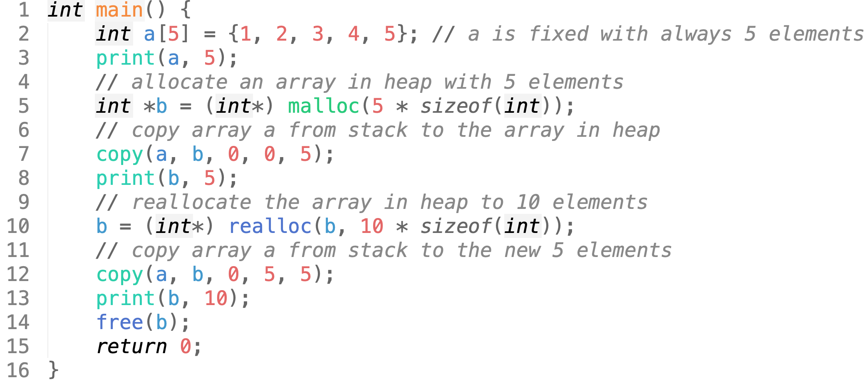
WHY POINTER? WHY HEAP?
Dynamic size arrays

Slide 26
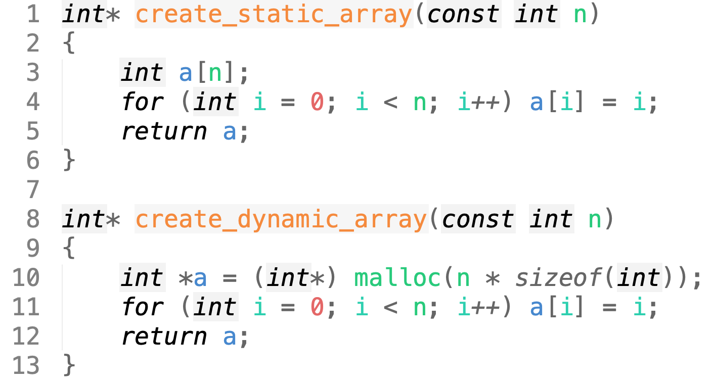
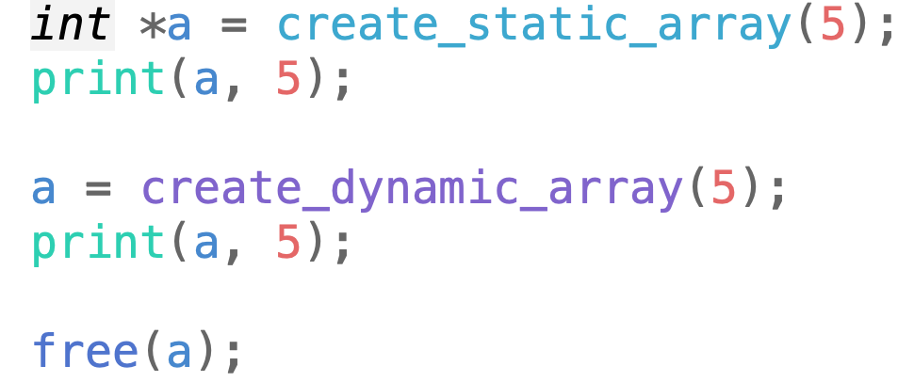
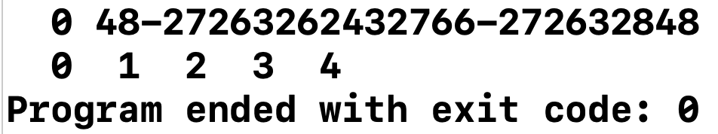
WHY POINTER? WHY HEAP?
Creating, returning an array in a function
Working with large array

Slide 27
MEMORY ERRORS
Access to memory bock which has not been allocated
Out of range
NULL
Forget to free memory (leaked memory)
Deallocate a memory block in heap which has already freed before

Slide 28
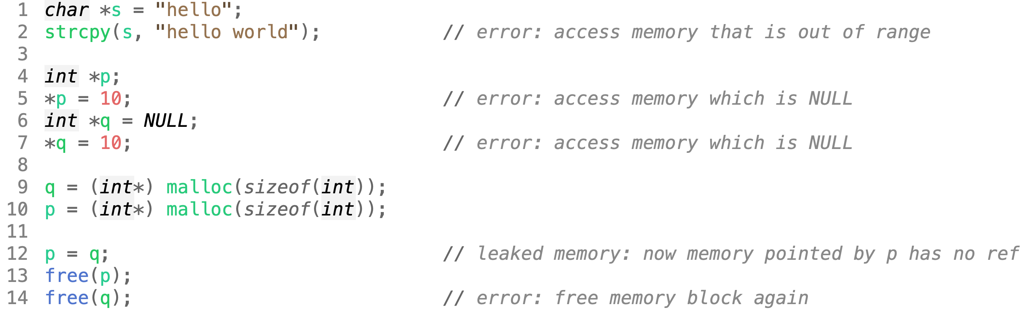
MEMORY ERRORS

Slide 29
REVIEW
Struct

Slide 30
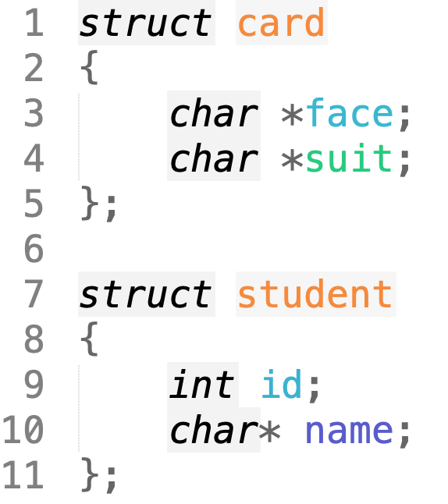
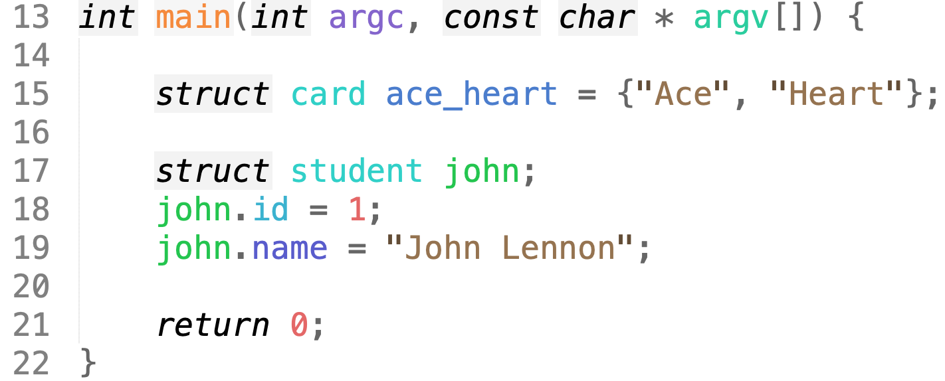
STRUCT
Structures are collections of related variables under one name.
Define and initialize a struct

Slide 31
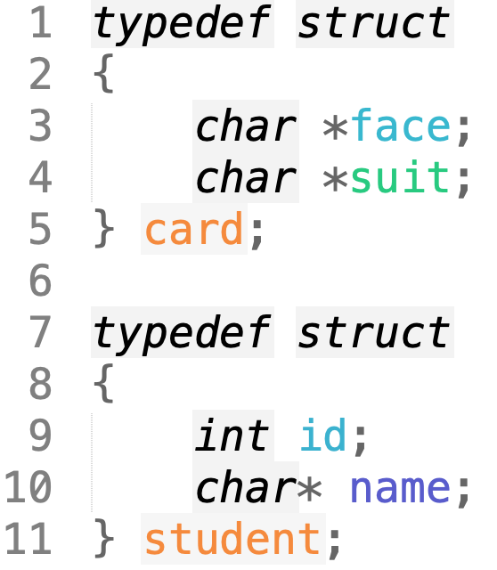
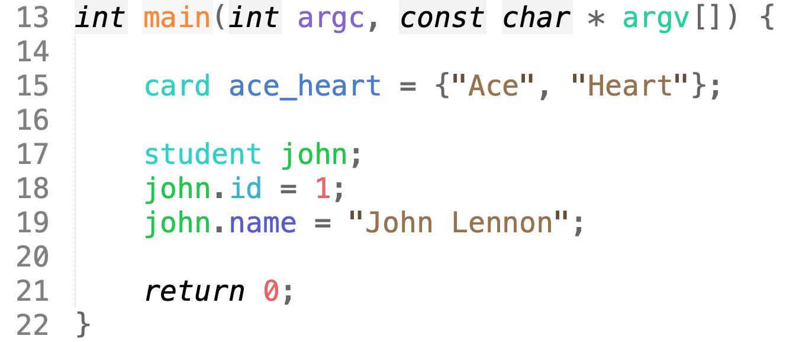
STRUCT
Structures are collections of related variables under one name.
Define and initialize a struct using typedef

Slide 32
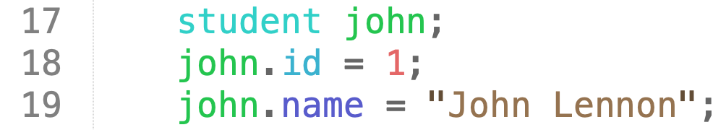
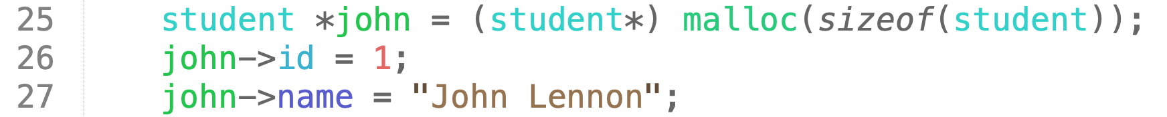
STRUCT
Accessing members of a struct
Structure member operator (.)
Structure pointer operator (->)

Slide 33
REVIEW
Functions & procedural programming

Slide 34
CODING CONVENTION
Length: should not be long, normally fit in a screen or ~ 25 lines of code
Function should do one thing and only one thing
Name should be clear and describe what ‘one thing’ is
Number of parameters should be limited

Slide 35
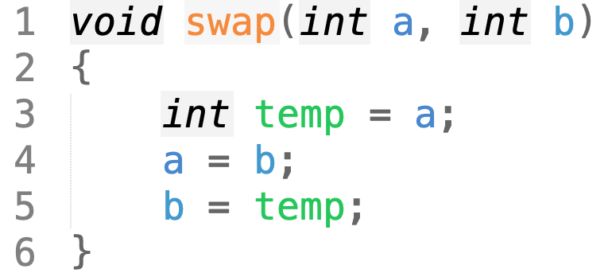
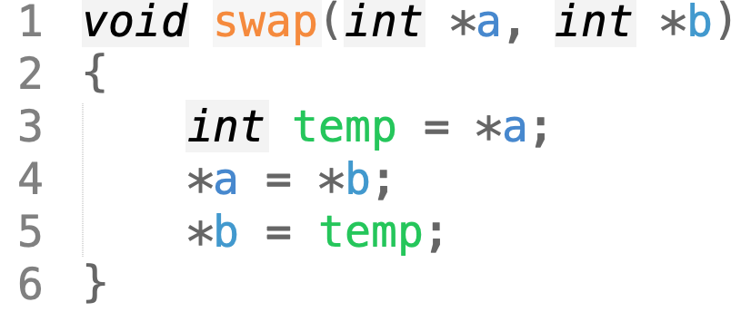
PASS BY VALUE VS REFERENCE
Parameter can be passed to a function by value
Value is copied from outside to the argument inside the function
or by reference (pointer)
Variable outside and memory block (pointed by pointer) inside the function is the same
doesn’t work as expected
work as expected

Slide 36
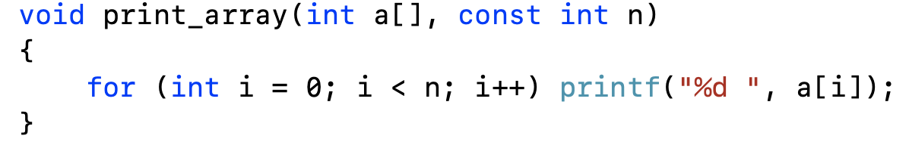
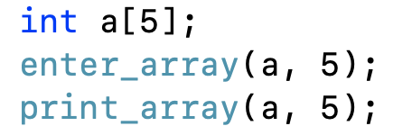
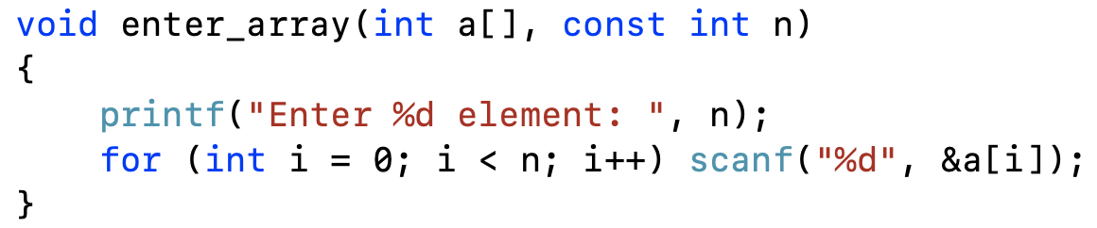
PASS ARRAY TO A FUNCTION
Array must be initiated before passing, need size as well
Cannot change array inside the function but can change content of array
Cannot change size of array

Slide 37
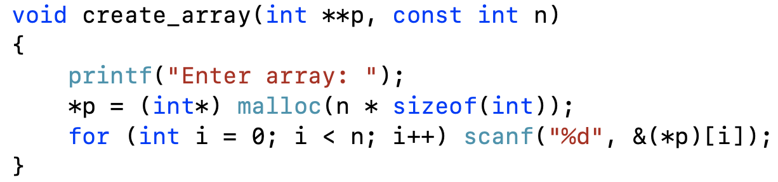
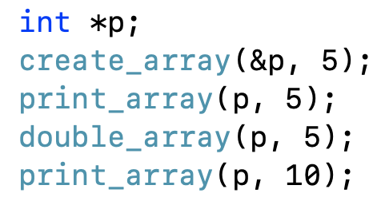
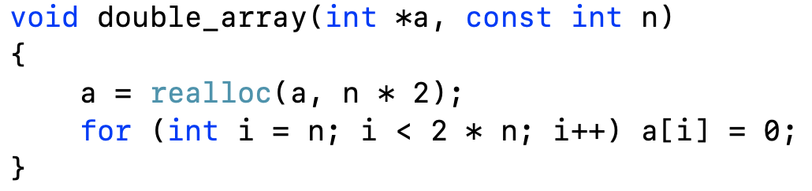
DYNAMIC ARRAY TO A FUNCTION
Must use pointer instead of array
May not need to be initiated before passing
Can change pointer (if needed), can change size

Slide 38
FUNCTION RETURNS ARRAY
If array is created in stack, return it outside is meaningless
Must use pointer and dynamic array in heap

Slide 39
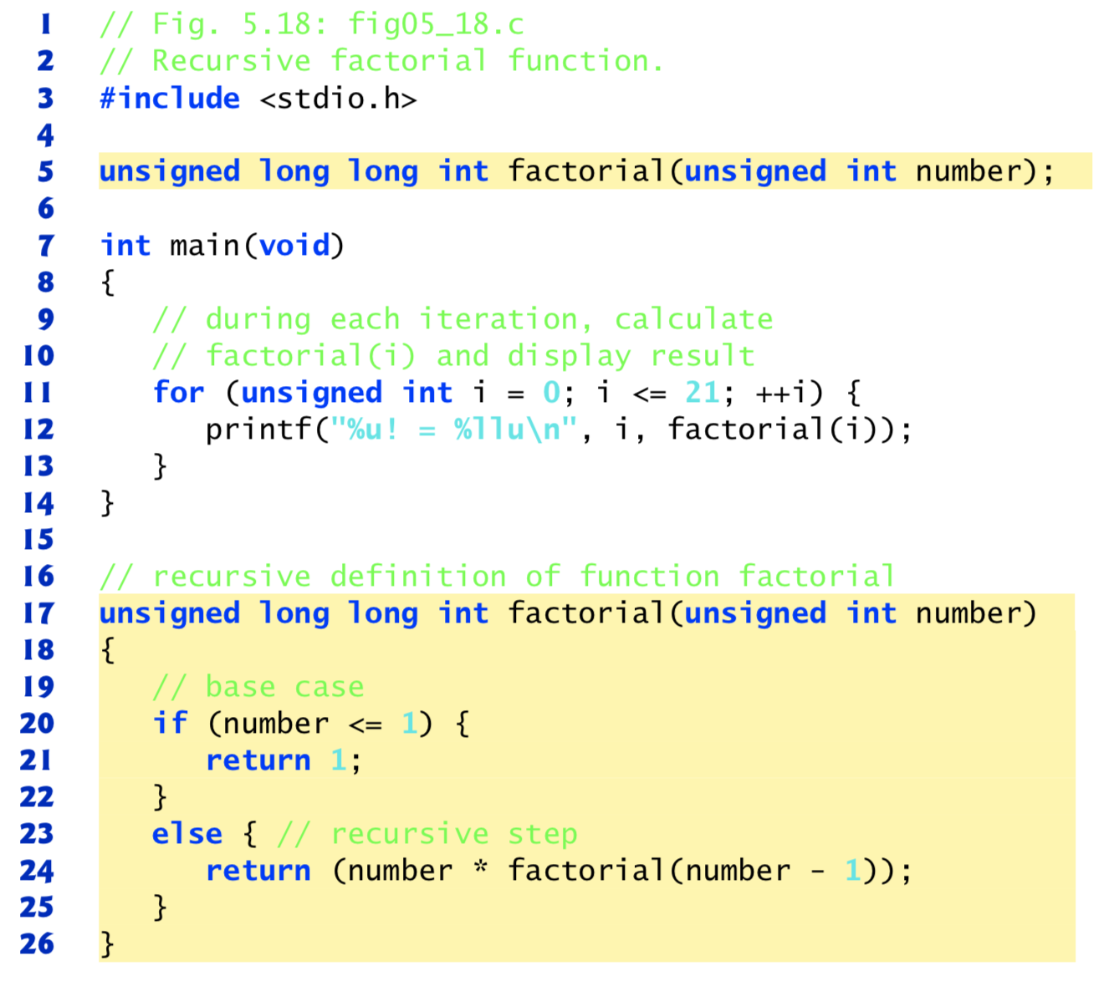
RECURSIVE FUNCTION
A recursive function is one that calls itself either directly or indirectly through another function.
base case: where it stops
recursive case: where it goes on
[1] C How to program 8th edition, Paul Deitel

Slide 40
PASSING A STRUCT TO A FUNCTION
Pass by value:
void print(student s);
Pass by reference:
constant content: void print(const student *s)
constant content & pointer: void print(const student* const s);
allow to change: void enter_student(student *s);

Slide 41
PROCEDURAL PROGRAMMING
Demo: A small menu-based program to manage students

